Slide 1




TRAFFIC FORECAST
AMAN DUBEY (CSE)
ADARSH PAL SINGH (E&TC)
AJAY KUMAR PRAJAPATI (CSE)
BIKRAM KUMAR PANDA (E&TC)
ARMY INSTITUTE OF TECHNOLOGY, PUNE

Slide 2
introduction

Slide 3
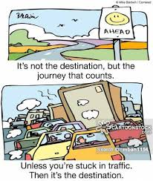
The Traffic Problem
Traffic congestion and vehicular emissions have become a major problem for road users in India.
A lot of time and fuel is wasted as the vehicles sit idly stuck in traffic jams.
Road accidents and pollution rise constitute the daily news. Lives are lost as ambulance, fire brigade do not make it in time.
Most conflicts between road users occur at intersections.

Slide 4
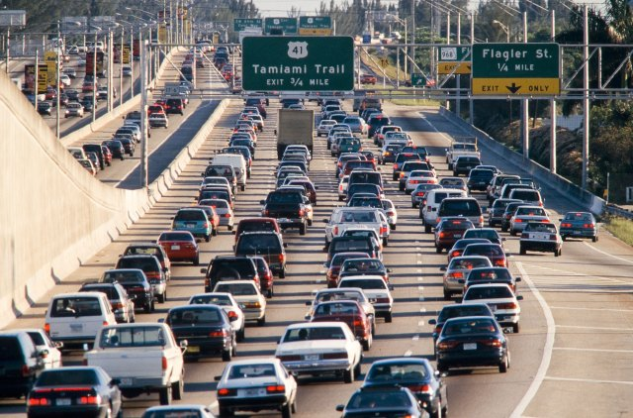
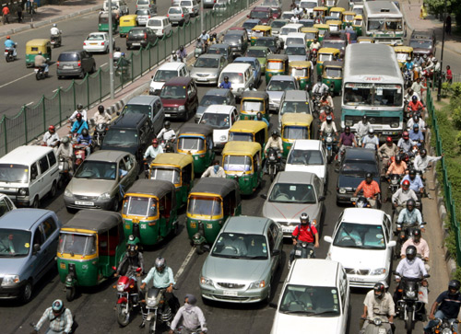
Challenges IN INDIA
HOMOGENEOUS TRAFFIC
HETEROGENEOUS TRAFFIC

Slide 5
TECHNOLOGY TODAY
GOOGLE MAPS
WAZE
TOMTOM GPS
Other older GPS: Gramin/Magellan

Slide 6
DEMO & EXPLANATION

Slide 7
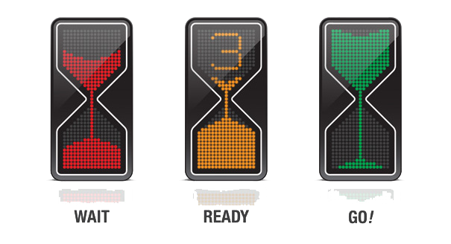
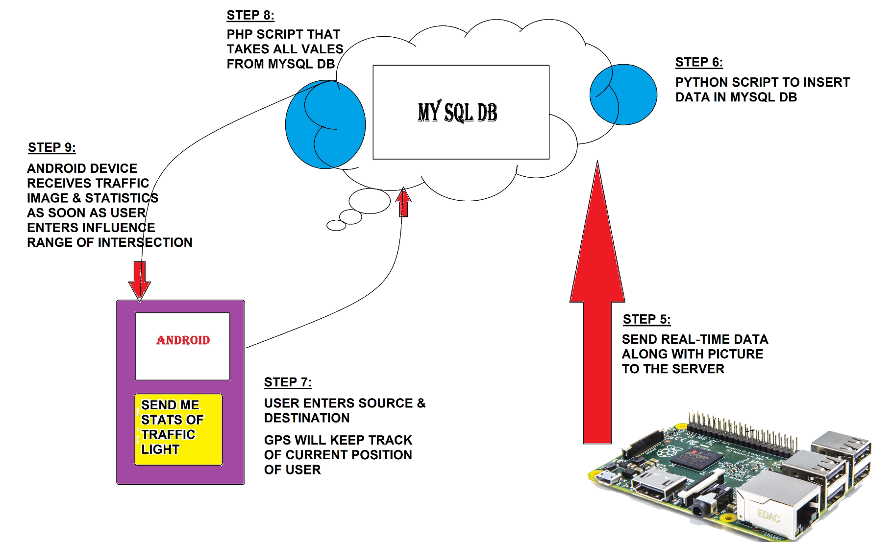
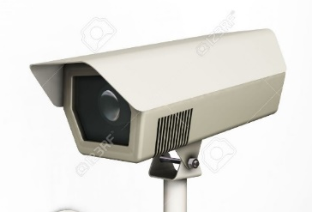
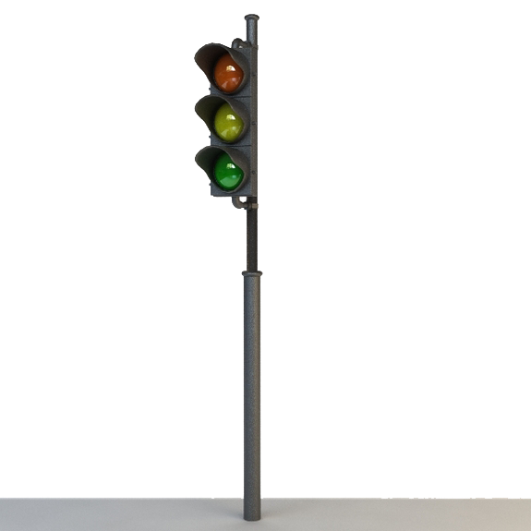
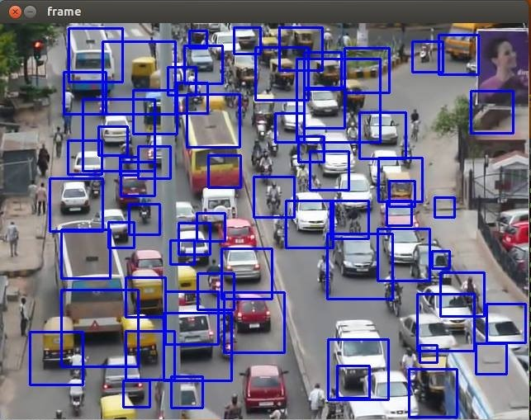
flowchart
STEP 4:
TIMER CONTROL AS PER TRAFFIC
STEP 1:
CAMERA TAKES IMAGES DURING RED SIGNAL
STEP 2:
SENDING IMAGE TO RASP PI
STEP 3:
TRAFFIC DENSITY CALCULATED

Slide 8
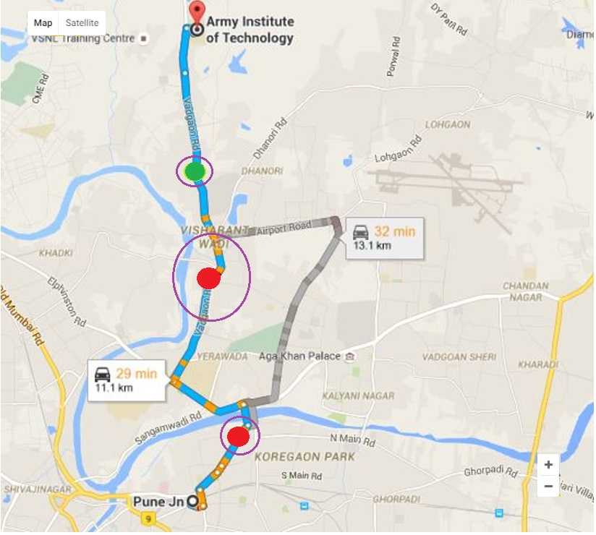
GPS SYSTEM

Slide 9

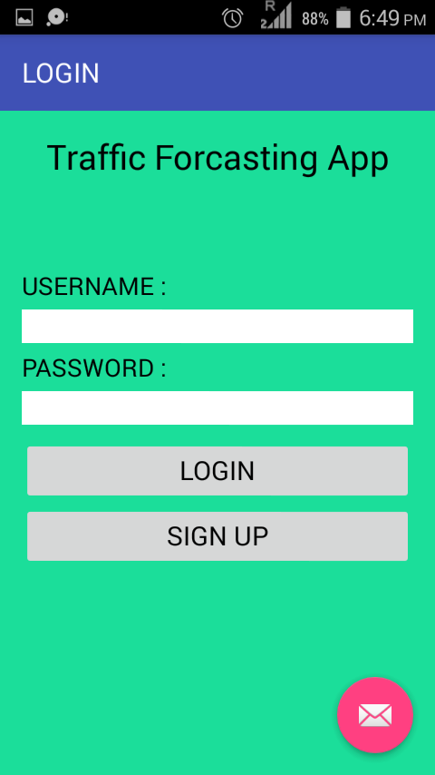
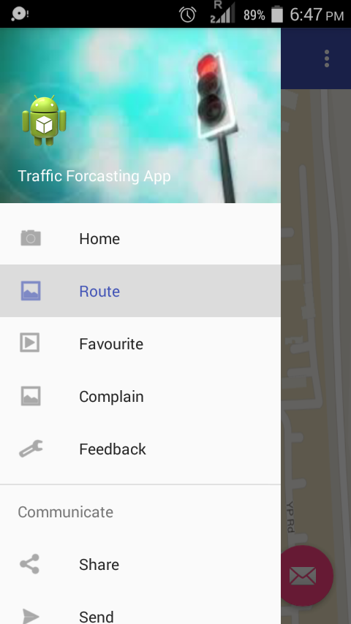
ANDROID APP

Slide 10
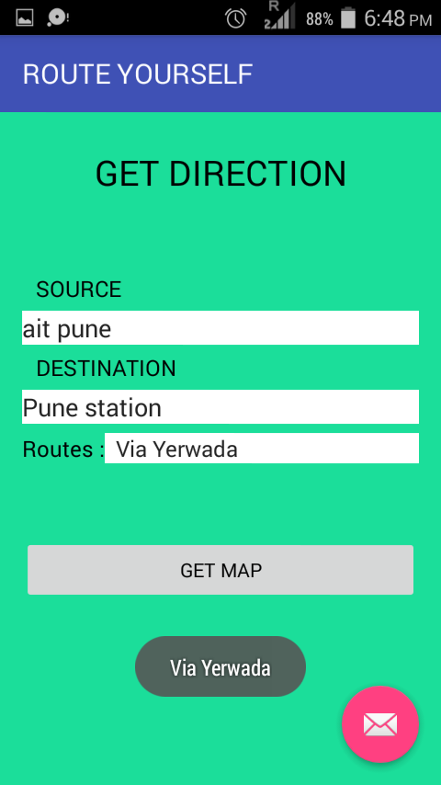
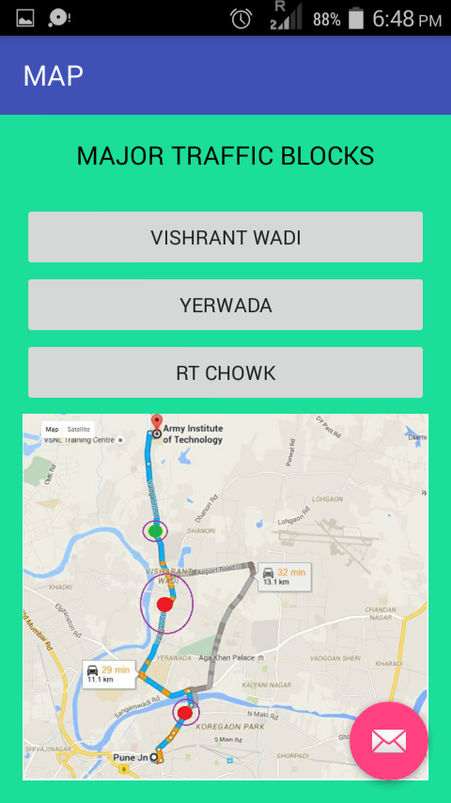
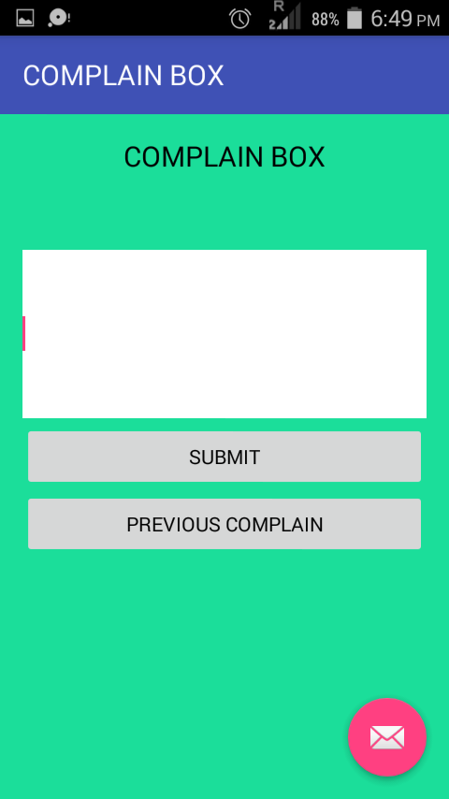

Slide 11
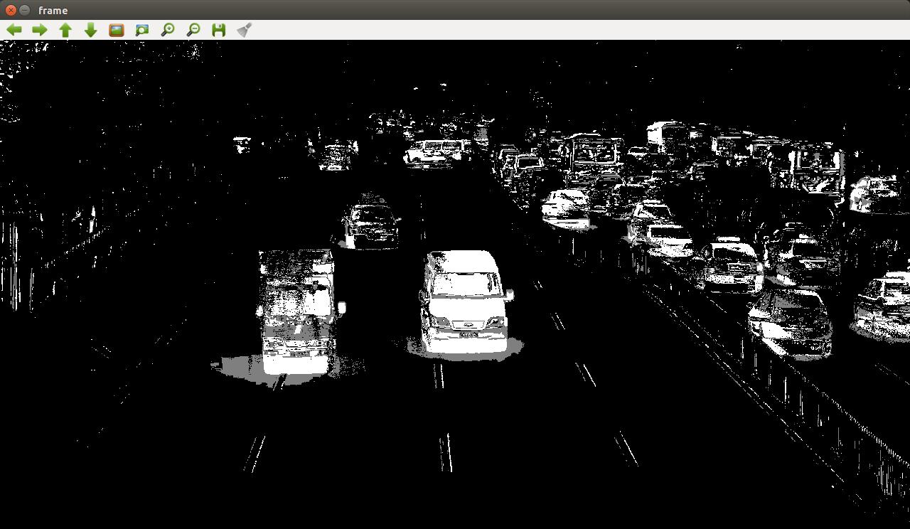
ALGORITHMIC APPROACH TO CONTROL TIMERS (IMAGE PROCESSING)
HAAR CASCADE
BACKGROUND SUBTRACTION

Slide 12
BUSINESS MODEL
General Public, State and Local Governments. Police Authorities, Ambulances will be benefited from this project.
As this whole idea is focused on making citizens’ life more comfortable and saving their precious time, and is to be implemented by the government there is not much room for revenue gain.
Government can finance the project, for its implementation.
If people find this app useful (saving time and money), then they can contribute for this.

Slide 13
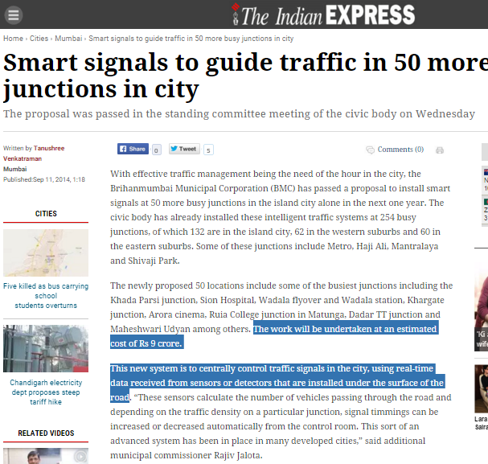
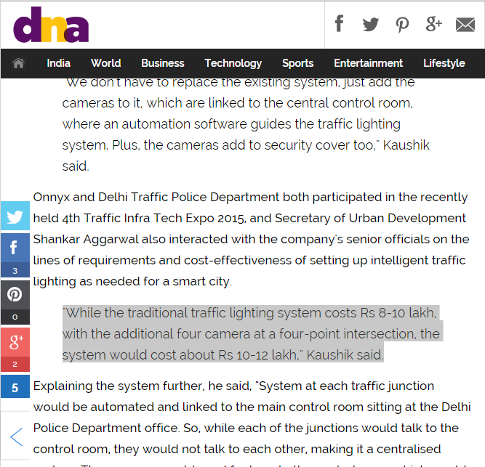
Our project can be implemented on existing traffic lights by adding cameras and a miniature computer like Raspberry Pi. The cost for upgrading each traffic light will not exceed 20,000.

Slide 14
FUTURE SCOPE
Our project is very versatile and so many features can be added in the future-
Special facility can be given to emergency vehicles. Signal will turn green to allow them to pass.
By tracking the real time speeds of vehicles at several intersections, a very accurate measure of total time can be made from source to destination.
After many people start using the app, a user based community service can be integrated to get timely updates on accidents and live condition of roads not managed by smart traffic light.

